Slide 1

The Wave of the Future: what issues are on the horizon for immigrants?
Metropolitan Washington DC, the Affordable Care Act, and Immigrants

Slide 2
Introduction
Daniel Choi
Attorney
Immigrant Advocacy Program
Legal Aid Justice Center
IMMIGRANTS
Metro DC Demographics
Affordable Care Act
What’s on the Horizon?

Slide 3
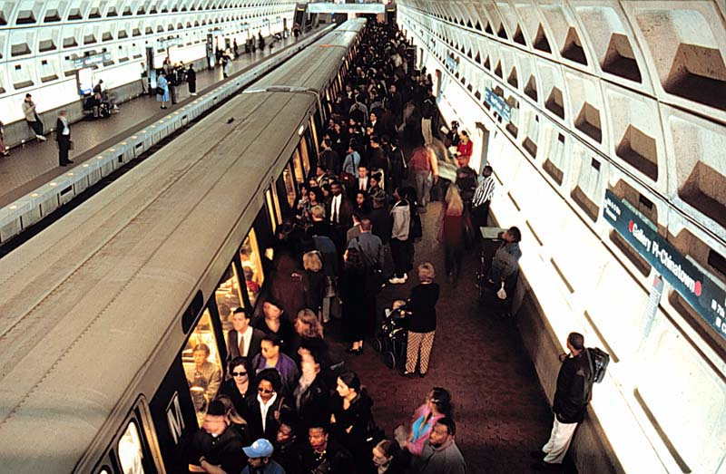
METRO DC DEMOGRAPHICS

Slide 4
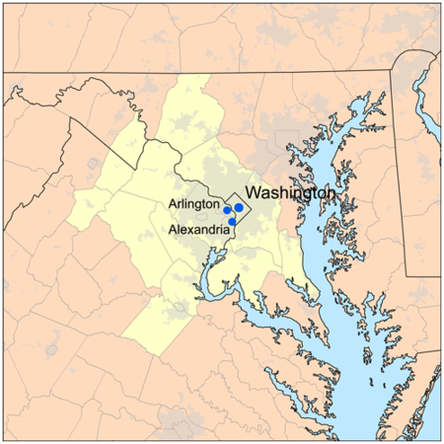
What’s Metropolitan Washington DC?
Metro DC Definition
Census Metropolitan Area is comprised of the:
DC: District of Columbia
MD: Calvert, Charles, Frederick, Montgomery, and Prince George's counties
VA: Arlington, Clarke, Fairfax, Fauquier, Loudoun, Prince William, Spotsylvania, Stafford, and Warren counties; Alexandria city, Fairfax city, Falls Church city, Fredericksburg city, Manassas city, and Manassas Park city
WV: Jefferson County
Source: http://www.census.gov/econ/census/snapshots_center/dc.html

Slide 5
The Numbers
Over 1 out 5 metro DC resident is foreign born
Most of the foreign born are from Latin America and Asia
Source: U.S. Census (ACS)

Slide 6
Gender and Age
SEX AND AGE | NATIVE | FOREIGN BORN | AFRICA | LATIN AMERICA | ASIA | EUROPE
Total population | 4,395,451 | 1,207,024 | 162,843 | 488,434 | 429,058 | 109,665
Male | 48.8% | 48.5% | 49.7% | 51.6% | 46.3% | 41.8%
Female | 51.2% | 51.5% | 50.3% | 48.4% | 53.7% | 58.2%
Under 5 years | 8.4% | 0.7% | 0.7% | 0.5% | 0.7% | 1.3%
5 to 17 years | 20.0% | 6.4% | 7.8% | 6.1% | 5.8% | 6.8%
18 to 24 years | 9.5% | 8.1% | 7.8% | 10.3% | 6.1% | 7.2%
25 to 34 years | 13.5% | 22.2% | 22.1% | 26.9% | 18.8% | 15.1%
35 to 44 years | 12.7% | 23.6% | 25.8% | 24.5% | 23.2% | 18.5%
45 to 54 years | 14.4% | 18.3% | 20.3% | 17.1% | 19.6% | 15.9%
55 to 64 years | 11.3% | 11.3% | 10.3% | 8.8% | 14.0% | 13.2%
65 to 74 years | 5.7% | 5.9% | 3.9% | 3.7% | 7.8% | 11.3%
75 years and over | 4.5% | 3.6% | 1.3% | 2.2% | 4.1% | 10.7%
Median age (years) | 33.8 | 40.2 | 39.3 | 37.3 | 42.9 | 45.7
18 years and over | 71.6% | 93.0% | 91.5% | 93.4% | 93.5% | 91.9%
21 years and over | 67.4% | 90.2% | 88.6% | 90.2% | 91.4% | 88.5%
62 years and over | 13.2% | 12.2% | 7.3% | 7.8% | 15.3% | 25.9%
65 years and over | 10.2% | 9.5% | 5.2% | 5.9% | 11.9% | 22.0%
Source: U.S. Census (ACS)

Slide 7
U.S. Citizenship and Entry
PLACE OF BIRTH, CITIZENSHIP STATUS AND YEAR OF ENTRY | AFRICA | LATIN AMERICA | ASIA | EUROPE | ALL FOREIGN BORN
Foreign born | 162,843 | 488,434 | 429,058 | 109,665 | 1,207,024
Foreign born; naturalized U.S. citizen | 70,082 | 148,538 | 256,449 | 60,177 | 542,010
Foreign born; not a U.S. citizen | 92,761 | 339,896 | 172,609 | 49,488 | 665,014
Entered 2000 or later | 50.1% | 41.9% | 35.3% | 33.6% | 39.8%
Entered 1990 to 1999 | 29.2% | 28.9% | 27.5% | 24.0% | 28.0%
Entered before 1990 | 20.7% | 29.1% | 37.2% | 42.4% | 32.2%
Source: U.S. Census (ACS)

Slide 8
Education Attainment
EDUCATIONAL ATTAINMENT | NATIVE | FOREIGN | AFRICA | LATIN AMERICA | ASIA | EUROPE
Population 25 years and over | 2,727,067 | 1,024,466 | 136,363 | 405,989 | 375,154 | 92,881
Less than high school diploma | 5.9% | 21.1% | 8.8% | 39.1% | 10.5% | 6.3%
High school graduate (includes equivalency) | 19.7% | 18.7% | 21.2% | 24.1% | 13.6% | 12.8%
Some college or associate's degree | 24.6% | 19.2% | 30.0% | 18.3% | 16.6% | 18.1%
Bachelor's degree | 26.2% | 20.8% | 23.8% | 10.7% | 29.8% | 23.2%
Graduate or professional degree | 23.5% | 20.1% | 16.2% | 7.8% | 29.5% | 39.6%
High school graduate or higher | 94.1% | 78.9% | 91.2% | 60.9% | 89.5% | 93.7%
Bachelor's degree or higher | 49.7% | 41.0% | 40.0% | 18.5% | 59.3% | 62.7%
Source: U.S. Census (ACS)

Slide 9
Income
INCOME IN THE PAST 12 MONTHS (IN 2011 INFLATION-ADJUSTED DOLLARS) | NATIVE | FOREIGN BORN | AFRICA | LATIN AMERICA | ASIA | EUROPE
Households | 1,579,753 | 467,570 | 68,694 | 171,986 | 169,524 | 49,714
Median household income (dollars) | 92,401 | 73,612 | 59,141 | 60,338 | 94,462 | 91,328
With earnings | 85.6% | 92.3% | 96.2% | 95.0% | 91.7% | 80.2%
With Social Security income | 20.8% | 13.0% | 6.5% | 9.5% | 15.3% | 26.1%
With Supplemental Security Income | 2.7% | 2.1% | 1.7% | 1.7% | 2.9% | 1.8%
With cash public assistance income | 1.9% | 2.0% | 2.5% | 2.5% | 1.6% | 0.9%
With retirement income | 21.4% | 7.4% | 4.3% | 4.9% | 7.4% | 19.6%
With Food Stamp/SNAP benefits | 5.8% | 6.9% | 7.7% | 9.8% | 5.0% | 2.9%
Families | 982,246 | 354,008 | 49,909 | 136,595 | 134,101 | 28,986
Median family income (dollars) | 113,884 | 78,723 | 63,691 | 58,676 | 103,705 | 122,234
Married-couple family | 74.5% | 73.6% | 65.2% | 62.8% | 84.8% | 85.4%
Median income (dollars) | 134,741 | 93,541 | 80,149 | 70,256 | 110,922 | 136,646
Male householder, no spouse present, family | 5.7% | 9.6% | 12.2% | 15.1% | 4.8% | 2.3%
Median income (dollars) | 69,805 | 51,611 | 52,142 | 45,512 | 73,077 | 83,344
Female householder, no husband present, family | 19.8% | 16.8% | 22.6% | 22.1% | 10.5% | 12.3%
Median income (dollars) | 55,121 | 46,648 | 43,149 | 38,398 | 62,465 | 61,434
Individuals | 4,395,451 | 1,207,024 | 162,843 | 488,434 | 429,058 | 109,665
Per capita income (dollars) | 43,314 | 38,455 | 33,373 | 27,771 | 45,990 | 58,386
Source: U.S. Census (ACS)

Slide 10
English Proficiency
LANGUAGE SPOKEN AT HOME AND ABILITY TO SPEAK ENGLISH | AFRICA | LATIN AMERICA | ASIA | EUROPE | ALL FOREIGN BORN
Population 5 years and over | 161,713 | 485,932 | 426,149 | 108,249 | 1,198,744
English only | 20.3% | 17.4% | 11.4% | 35.2% | 18.1%
Language other than English | 79.7% | 82.6% | 88.6% | 64.8% | 81.9%
Speak English less than "very well" | 24.1% | 52.2% | 38.6% | 17.4% | 39.7%
Source: U.S. Census (ACS)

Slide 11
Health Insurance Coverage of Immigrants
HEALTH INSURANCE COVERAGE | NATIVE | FOREIGN BORN | AFRICA | LATIN AMERICA | ASIA | EUROPE
Civilian non-institutionalized population | 4,321,783 | 1,200,547 | 162,158 | 485,942 | 426,896 | 108,644
With private health insurance | 81.6% | 62.7% | 62.6% | 46.1% | 74.3% | 87.2%
With public coverage | 21.8% | 13.8% | 14.4% | 11.4% | 14.1% | 21.8%
No health insurance coverage | 7.0% | 29.0% | 26.5% | 45.9% | 17.5% | 6.8%
Source: U.S. Census (ACS)

Slide 12
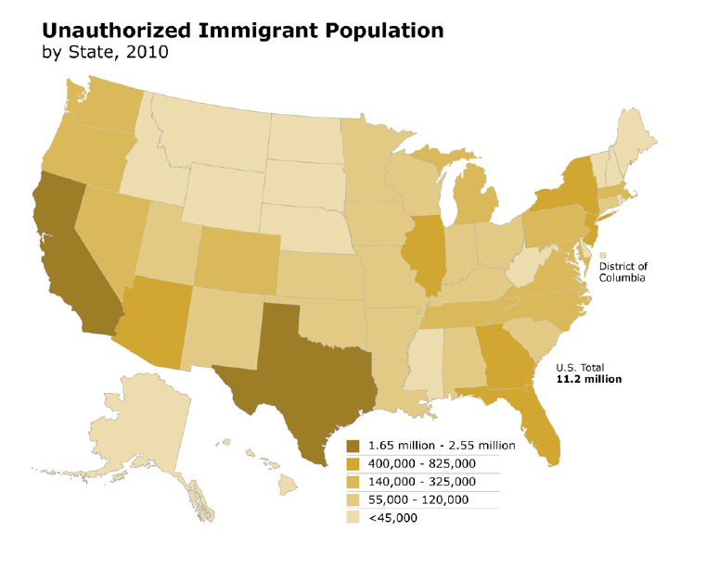
Unauthorized Immigrants
Source: Pew Hispanic Center

Slide 13
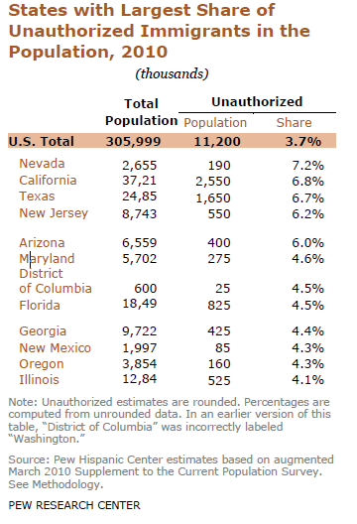
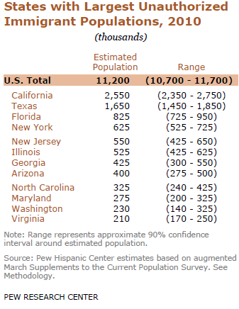
DMV Unauthorized Numbers

Slide 14
HIGHLIGHTS
Over 1 in 5 people in the DC metro area is foreign-born. Over 1.2 million immigrants in the DC metro area.
93% of immigrants are over 18 years old (compared to 71.6% for natives) and more working age. (note: Immigration status and race/ethnicity are different things. Many foreign-born adults may have U.S. born/U.S. citizen children or siblings.)
Majority of these immigrants (665,014) are not U.S. citizens and have varying immigration legal statuses (LPR, TPS, Undocumented, etc.)
21.1% of DC metro immigrants do not have a high school diploma (compared to 5.9% of native population).
A foreign-born household makes $18,789 less than a native-born household. Only Asian foreign-born households make very slightly more than their native counterpart. (Note: Foreign-born people get more income from earnings than their native counterpart.)
Nearly 40% of these immigrants entered recently (entered 2000 or later) and may still be adapting to U.S. culture and customs
Over 80% speak a language other than English at home, and nearly 40% do not speak English very well.
29% of immigrants do not have any health insurance. 45.9% of immigrants from Latin America do not have any health insurance.
A significant portion of the DC metro foreign-born population is undocumented.

Slide 15

Patient Protection and
Affordable Care Act

Slide 16
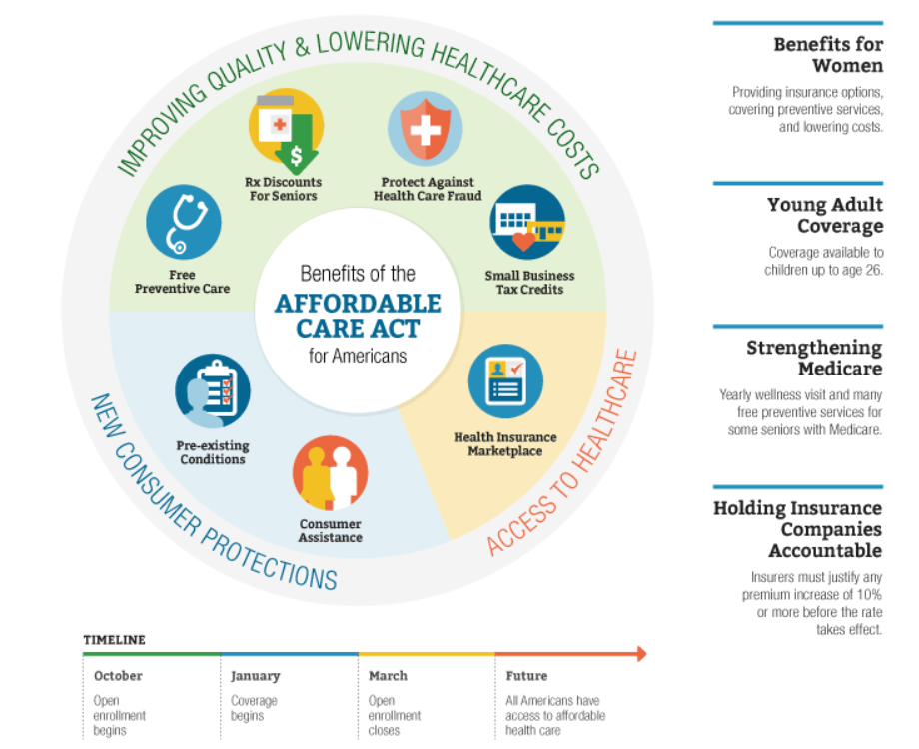
Benefits of the Affordable Care Act
Source: http://www.hhs.gov/healthcare/facts/timeline/index.html

Slide 17
The Affordable Care Act and Fighting Fraud
The Affordable Care Act, the health care law, takes powerful steps toward combating health care fraud, waste, and abuse. The government has recovered a record-breaking $10.7 billion in recoveries of health care fraud in the last three years. Some of the new tools the Affordable Care Act has put in the hands of fraud fighters:
Tough new rules and sentences for criminals: The law increases federal sentencing guidelines for health care fraud by 20-50% for crimes with over $1 million in losses.
Enhanced screening: Providers and suppliers who may pose a higher risk of fraud or abuse are now required to undergo more scrutiny, including license checks and site visits.
State-of-the-art technology: To target resources to highly suspect behaviors, the Center for Medicare & Medicaid Services now uses advanced predictive modeling technology.
New resources: The law provides an additional $350 million over 10 years to boost anti-fraud efforts.
Source: http://www.stopmedicarefraud.gov/aboutfraud/aca-fraud/index.html

Slide 18
ACA and Immigrants
EXISTING HEALTH AND SAFETY NET PROGRAMS
INDIVIDUAL MANDATE
TAX CREDITS/SUBSIDIES
STATE HEALTH INSURANCE EXCHANGE (a.k.a. State Health Insurance Marketplace)
ESSENTIAL HEALTH BENEFITS

Slide 19
Naturalized U.S. Citizens
Complete Federal Coverage
Completely the same rights and obligations as any other U.S. citizen

Slide 20
Lawfully Present Immigrants
Limited federal coverage
Subject to the individual mandate and related tax penalty (exempt if low-income or meet specific criteria)
May enroll in a “qualified health plan (QHP)” from the state insurance exchanges
Eligible for premium tax credits and lower copayments
No waiting periods for enrolling in state insurance exchanges or premium tax credits
Eligible for the Pre-Existing Condition Insurance Plan (PCIP) and the Basic Health Plan (when available in state)
Current federal immigrant eligibility restrictions in Medicaid maintained, including the five-year-or-more waiting period for most lawfully residing, low-income immigrant adults
Since April 2009, states can choose to provide Medicaid and Children’s Health Insurance Program (CHIP) benefits to lawfully residing children and pregnant women without a waiting period. But in states that do not elect this option, these children and pregnant women must still wait five years or more before they can get affordable health care coverage.
EXCEPTION: As of August 2012, Deferred Action for Childhood Arrivals (DACA) grantees are ineligible for Medicaid, CHIP, and ACA benefits.
Source: National Immigrant Law Project

Slide 21
Unauthorized Immigrants
No federal coverage
Not allowed to purchase private health insurance at full cost in state insurance exchange(s)
Not eligible for premium tax credits or lower copayments
Exempt from individual mandate
Not eligible for Medicare, nonemergency Medicaid, or CHIP
Remain eligible for emergency care under federal law
Eligible for Emergency Medicaid if low-income
Citizens or lawfully present children of undocumented parents are eligible:
  To purchase from the state insurance exchange
  For premium tax credits and lower copayments
  For Medicaid or CHIP
May seek nonemergency health services at community health centers or safety-net hospitals
Source: National Immigrant Law Project

Slide 22
How would Comprehensive Immigration Reform affect ACA?
The Border Security, Economic Opportunity, and Immigration Modernization Act of 2013 (S. 744) is the Senate’s version of comprehensive immigration reform.
Registered Provisional Immigrants (RPIs)
No individual mandate
May purchase full-cost health insurance in the new ACA-created insurance marketplaces
No subsidies, in the form of tax credits and cost-sharing reductions
W-Visa
Individual mandate
Considered “lawfully present” and eligible to purchase insurance in the new insurance marketplace and apply for subsidies
Not considered “qualified” immigrants under the 1996 welfare law and ineligible for federal means-tested public benefits test

Slide 23
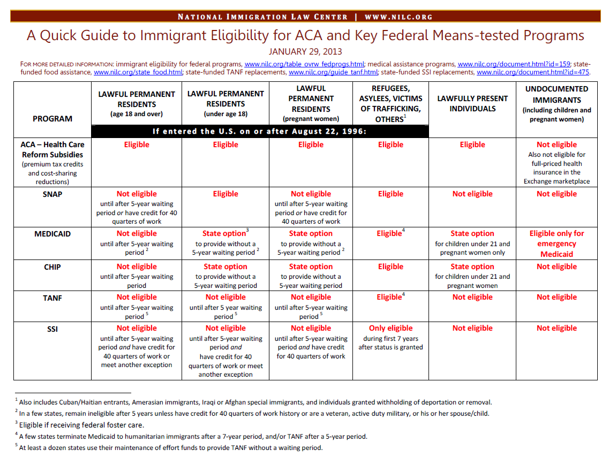

Slide 24
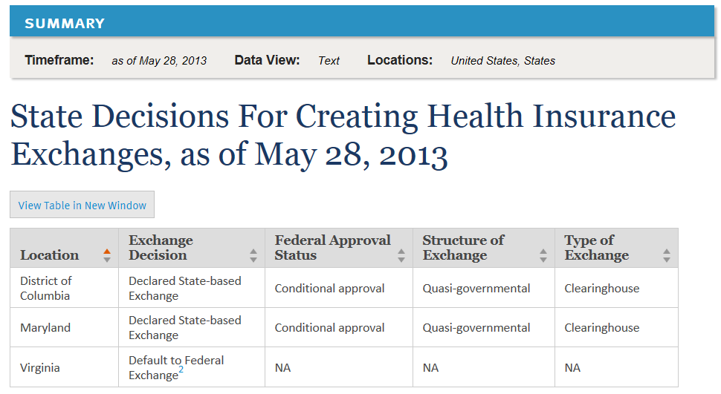
State Exchanges and Essential Health Benefits
Source: Kaiser Family Foundation - http://kff.org/health-reform/state-indicator/health-insurance-exchanges/

Slide 25

What’s on the horizon?

Slide 26
IMMIGRANTS WILL BE DIRECTLY EFFECTED
A significant number of immigrants will now be required to search for and purchase insurance: 29% of foreign-born (~$348,158 people) in the DC metro area are uninsured. Many will be purchasing insurance for themselves and their families (possibly for the first time in their lives).
Many immigrants will not know which requirements they have to follow: 665,014 foreign-born are not U.S. citizens and have varying immigration statuses.
Many immigrants will have difficulty understanding all their options: 21.1% of the foreign-born in the DC metro area have less than a high school education and 39.7% do not speak English well. Options under state exchanges and essential health benefits may vary widely.
Many immigrants will be prohibited from purchasing insurance in the United States: Approximately 510,000 undocumented people in Washington D.C., Virginia, and Maryland will be prohibited from participating in state exchanges. They will have to rely almost exclusively on free local clinics and emergency rooms.
AFFINITY FRAUD
MEDICAL DEBT CASES (INCL. UNFAIR DEBT COLLECTION PRACTICES)
UNLICENSED PRACTICE OF MEDICINE

Slide 27
Outreach and Education
Ethnic Media
Grassroots Community Partners
Language Access
A great amount of outreach and education will be needed to prevent and address consumer fraud

Slide 28

Daniel Choi
Attorney
Legal Aid Justice Center – Immigrant Advocacy Program
6400 Arlington Blvd, suite 600, Falls Church, VA 22042
Tel: (703) 778-3450 ext. 409
Fax: (703) 778- 3454
Email: danc@justice4all.org

